Slide 1
Login Page FlowChart
Email과 Password 입력
Users table
Register 클릭
Alert!
이메일 또는 비밀번호가 맞지 않습니다!
N
적절한 Email과 Password?
Register 페이지로 이동
Y
Survey 페이지로 이동

Slide 2
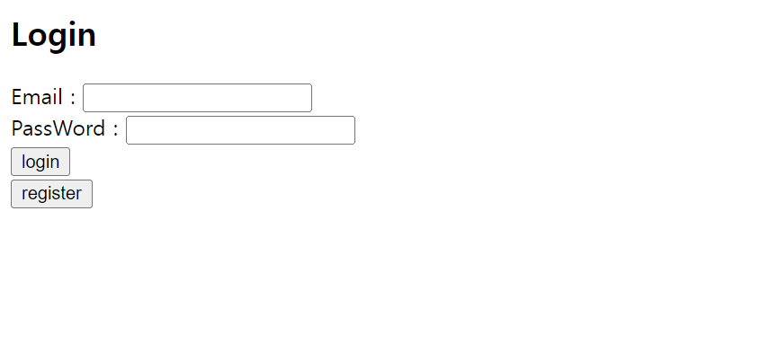
로그인 페이지
Register를 하고 email, password를 치면 설문조사 페이지에 연결.

Slide 3
Register Page FlowChart
이메일 입력
Alert!
이름을 입력해주세요
Or
비밀번호 확인이 맞지 않습니다
이름 입력 및 입력한 비밀번호와 비밀번호 확인 일치?
N
이메일 중복 체크 클릭
search
Y
Users table
update
Users table
Alert!
이미 사용 중인 이메일입니다!
N
중복되지 않은 Email?
Login 페이지로 이동
Y
Alert!
사용 가능한 이메일입니다!
이름, 비밀번호, 비밀번호 확인 입력

Slide 4
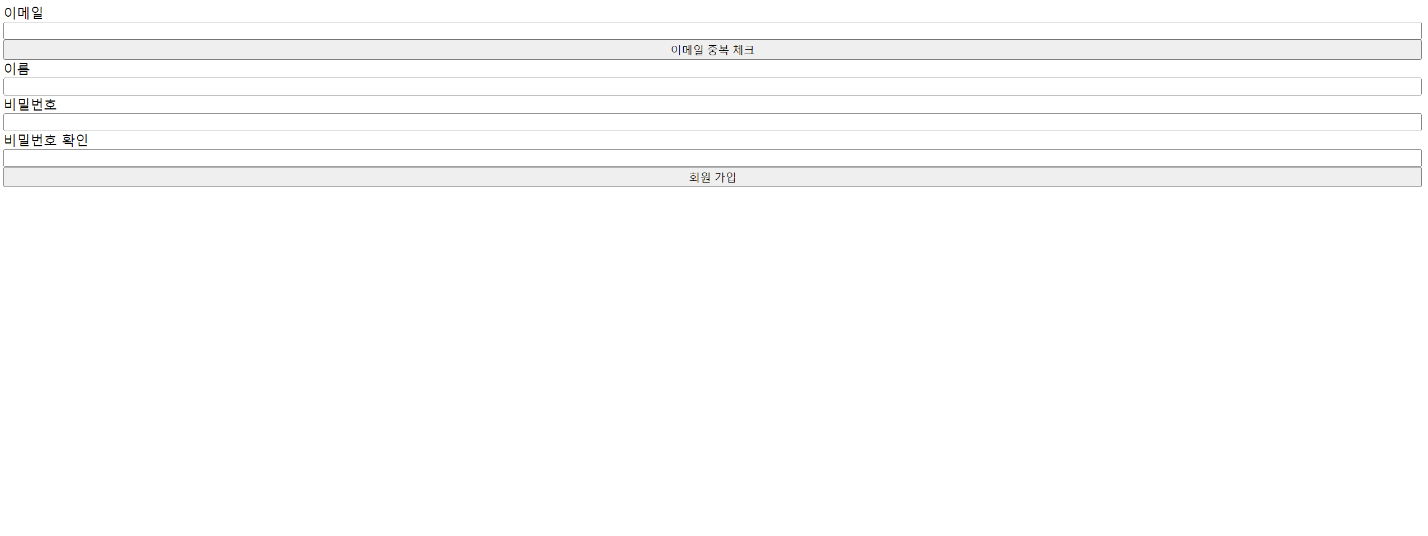
회원가입 페이지
이메일, 이름, 비밀번호, 비밀번호 확인을 모두 적절히 입력해야 정상적으로 회원가입.
회원가입을 하면 회원가입을 한 순서대로 자동으로 그룹이 배정. (한 그룹당 4명이 되게)

Slide 5
Survey Page FlowChart
나이, 성별, 교육 배경, 최종 학력 등의 설문 항목 입력
Alert!
oo을 입력해주세요!
각 항목 입력?
N
Y
update
Users table
Alert!
설문이 완료되었습니다.
Notice 페이지로 이동.

Slide 6
설문조사 페이지
설문 내용이 추가되거나 변경되면 아래의 항목은 수정할 예정.
Age
Gender
Education Background
Final Degree
Submit

Slide 7
Notice Page FlowChart
Ok 버튼 클릭
Group type에 따른 initial prediction 페이지 이동

Slide 8
설명 페이지
실험 시작 전 참가자들에게 제시.
일정 시간이 지나면 자동으로 그룹별 페이지로 이동.
Direction
Individuals in a team participate in a game in which they need to sell 10 bitcoins given to each team at a price agreed by team members (team average). They can sell only one coin at a time. Accordingly, they have 10 chances to sell their coins. In the game, individuals can suggest expected and desired prices two times: before and after recognizing their teams’ average price or AI suggested price.
Individuals need to suggest their own expected price based on their understanding of the market within 30 seconds. Once all team members complete to suggest their prices, individuals can see team average prices and/or AI suggested prices. Then, within a minute, they have a chance to revise their initial expected prices by clicking YES for the question “will you change your initial estimate?” on the screen and then they can suggest final expected prices. If individuals click NO on the screen, their initial expected price will used for the calculation of team average price.
When all team members complete to suggest their final expected prices, team average value will be calculated. If the team value is in the range of +/ 5% of the price at the time when team average values are calculated, the coin will be sold with the suggested price. If the price is outside the range, the coin will not be sold and teams’ cash settlement will fail. Over the 10 chances, the amount of cash only for the successful deals will be accumulated. Team performance will be counted based on the amount of cash that the team obtained. Based on the performance, team members can share their profits (accumulated cash they gain from selling the coins, divided by 1,000 and by the number of contributions (when participants miss their chance to suggest, the contributions will not be counted).

Slide 9
Initial Prediction Page FlowChart
Initial prediction 입력
3분 안에 입력?
N
값 NULL로 설정
Y
update
Prediction table
Final prediction 페이지 이동.

Slide 10
실험 페이지
3분 안에 initial price 입력하고 submit 클릭.
Test n
The number of coins
Other member
1’s price
Other member
2’s price
Bitcoin Price
The amount of cash
Other member
3’s price
Other member
4’s price
Please suggest the price of a coin at which your team should sell within 3 minutes
Remaining time
Initial price (input)
Submit

Slide 11
Final Prediction Page FlowChart
Whether to change 입력
Final price 입력
1분 안에 입력?
N
값 0 (No)로 설정
30초 안에 입력?
N
값 NULL로 설정
Y
update
Y
update
Prediction table
Prediction table
Final price input 활성화
Initial Prediction page로 이동

Slide 12
실험 페이지
Test n
The number of coins
Team Average or (Fake or Real) AI Recommendation
Bitcoin Price
The amount of cash
You can change your initial price within a minute. Will you change your initial price?
Remaining time
Yes
No
You should enter your final price within 30 seconds.
Remaining time
Final Price (input)
Submit

Slide 14
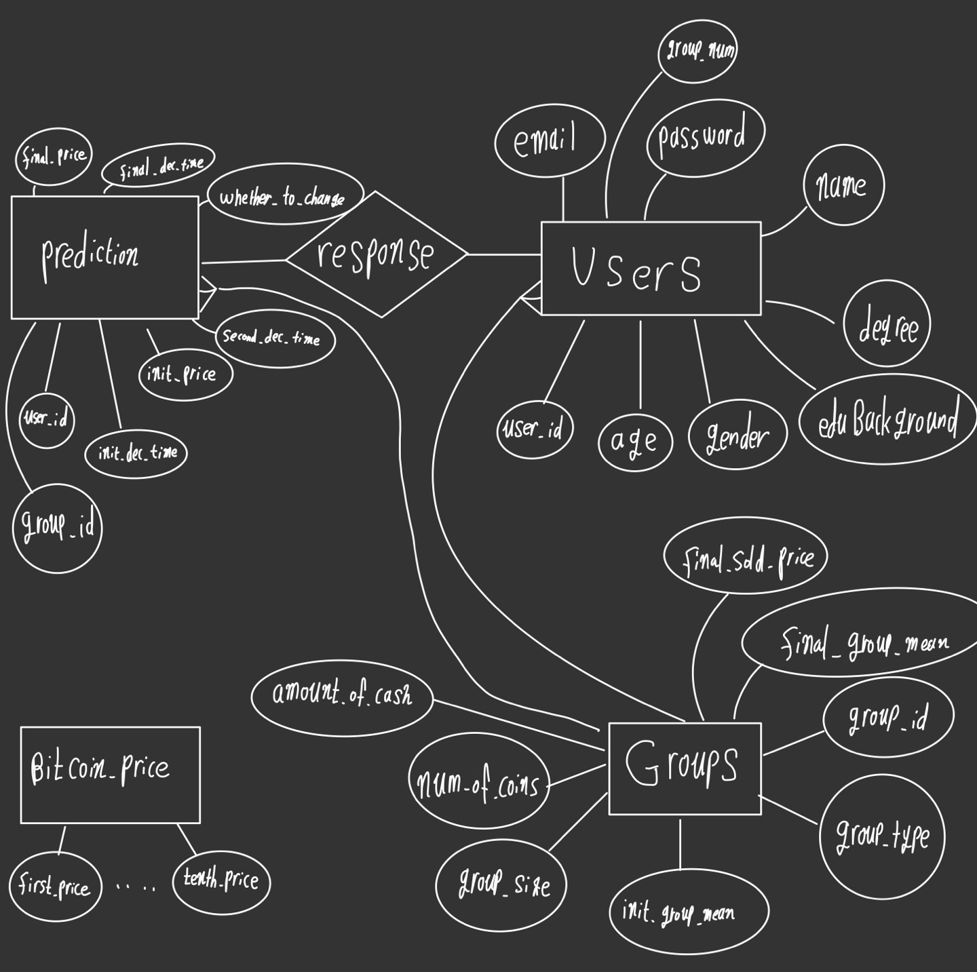
ER-Diagram.

